Slide 1
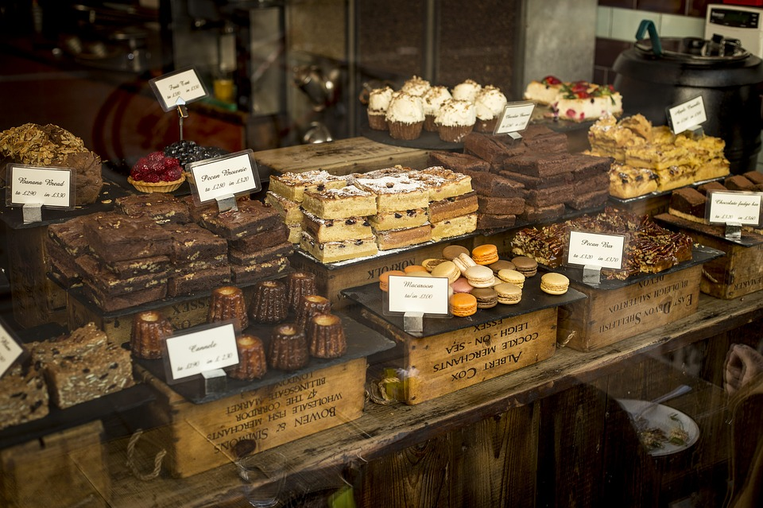
Online chocolate Shop Management
System
Presented by: Crazy Engineers

Slide 2




team
Md Nazim Uddin
Md. Naeemul Hasan
Janith Sultana JUTHI
Priyanka Rani Satu
CSE 063 07429
CSE 063 07380
CSE 063 07438
CSE 063 07477

Slide 3

Objectives
Interview questions
Understanding the automated system
Prerequisite and highlights Analysist
Understanding the customer demand
Use case diagram design
Data flow diagram design
Class diagram design
Creating database and website.

Slide 4



Information gathering we have picked three techniques
Interview
Questionnaire
Investigation

Slide 5

Interview
Audio record of our investigation.
6 Open-Ended question.
4 Close-Ended question.

Slide 6



Interview
legends Group
Nahidul Amin
Rijvi Alam Rabby
Tanjim Amin Koushik
CSE 063 07394
CSE 063 07474
CSE 063 07465
Student at Stamford University Bangladesh
Student at Stamford University Bangladesh
Student at Stamford University Bangladesh

Slide 7
Question
01. How can i maintain this project by a software properly?
Ans: You can maintain this project by a software to follow the similar types of software, Because we are not professional engineer. so we will give you that suggestion.
02. How can i maintain the ordering system from the customer?
Ans: When the customer order any product i give some rules for ordering system and then ask to confirm that order.
03. What is the procedure behind choosing the customers of chocolate?
Ans: Firstly they choice the brand and if they click this brand then they can see the price, categories, flavor and other etc.

Slide 8
Question
04. How does a customer speak with the framework?
Ans: Customer can speak with the framework by massaging and phone call system.
05. How can our increasing online customer service?
Ans: you can give advertisement of this online chocolate service in popular online side.
06. Do you think this types of chocolate product is highly cost for the customers?
Ans: No, But it is the personal thinking side of customers.
07. Could the customers get the information of the new chocolate the web?
Ans: Of course.

Slide 9
Question
08. Automated system process is easier or difficult?
Ans: Obviously easier.
09. Do you think that the customers are satisfied of this products?
Ans: Yes
10. Do you see any bad side of our automated system?
Ans: No.

Slide 10

Questionnaires
There were 11 inquiries in the overview and every one of them were explicit.

Slide 11
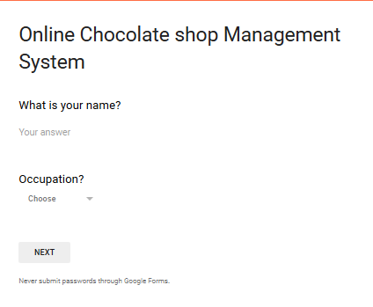
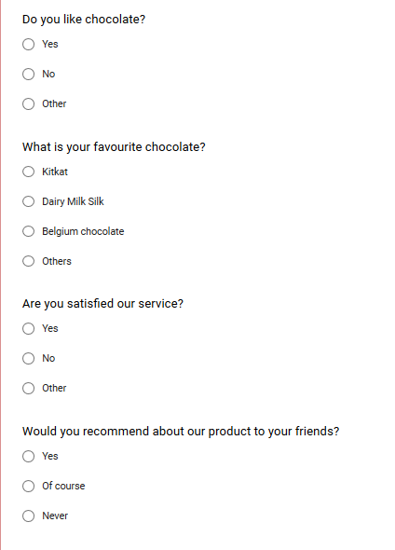
Questionnaires

Slide 12
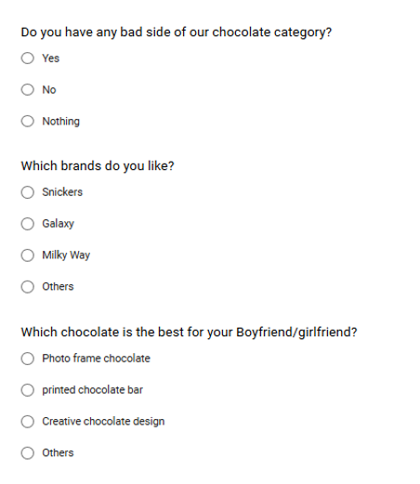
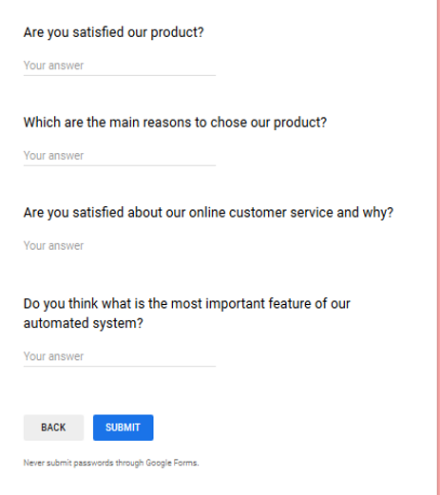
Questionnaires

Slide 13
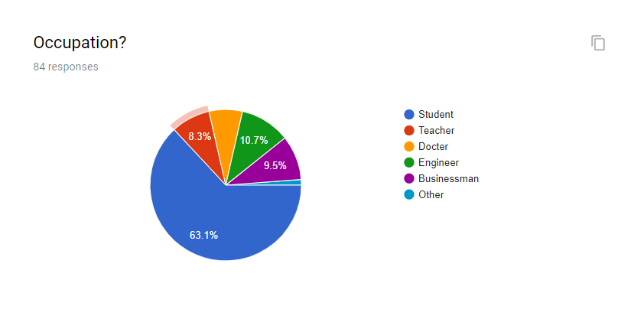
Survey Results

Slide 14
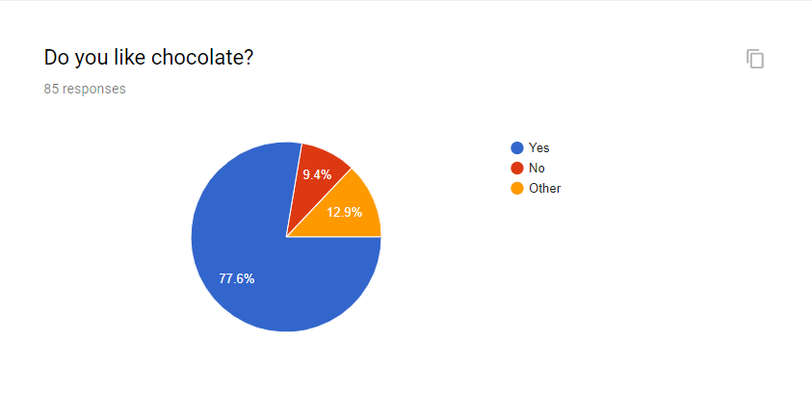
Survey Results

Slide 15
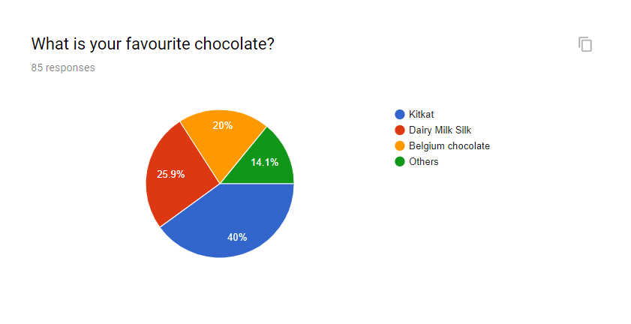
Survey Results

Slide 16
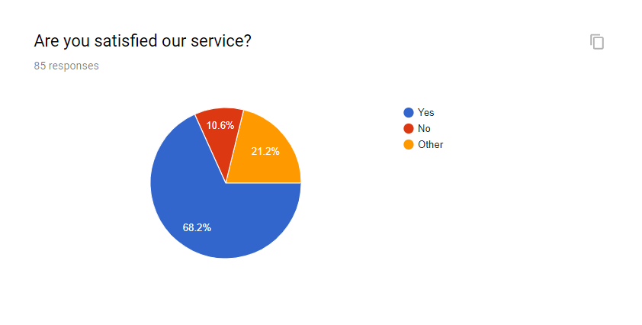
Survey Results

Slide 17
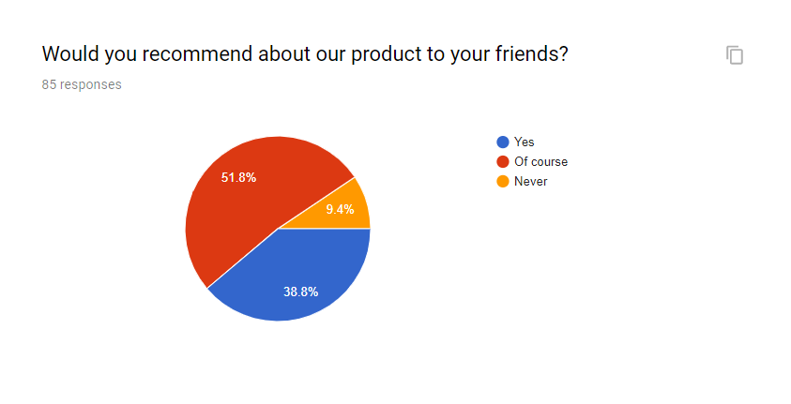
Survey Results

Slide 18
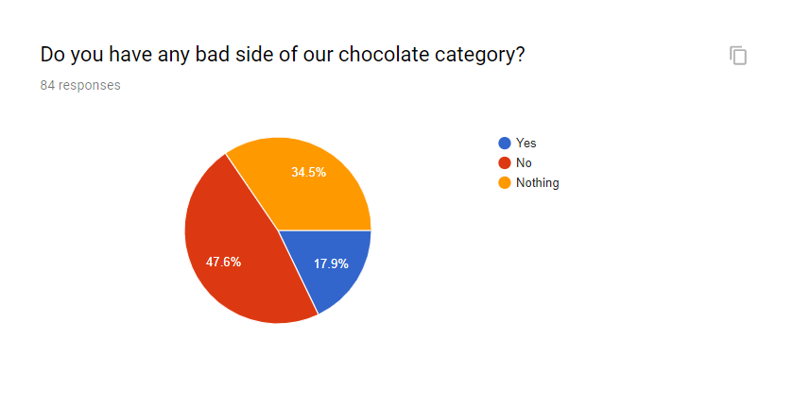
Survey Results

Slide 19
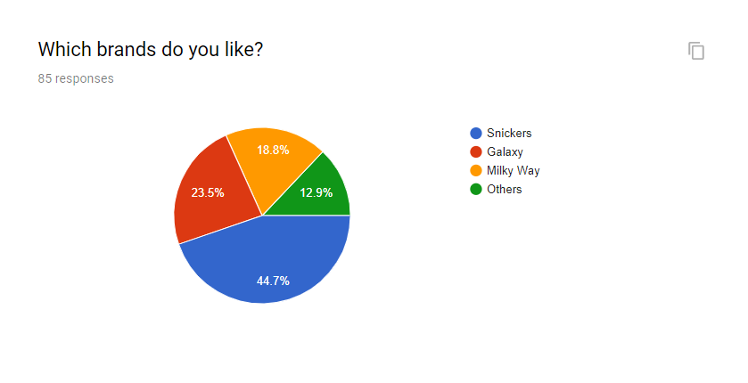
Survey Results

Slide 20
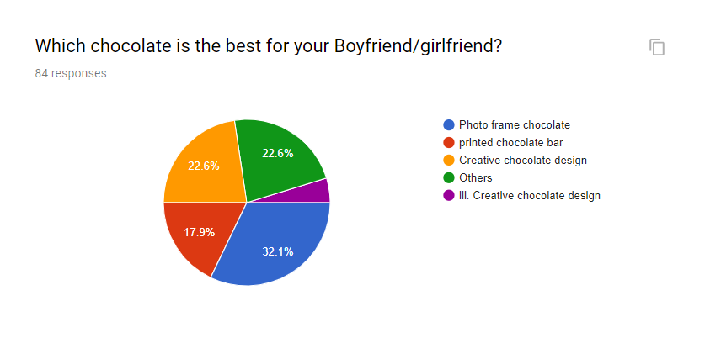
Survey Results

Slide 21
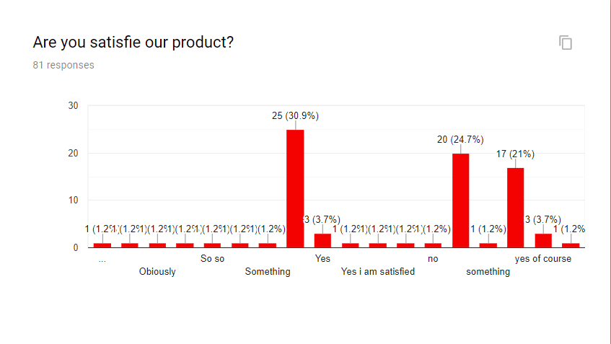
Survey Results

Slide 22
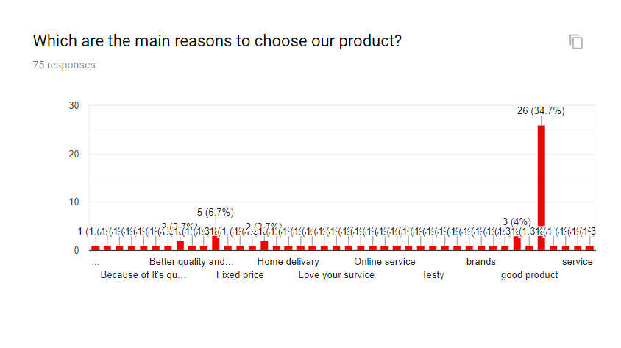
Survey Results

Slide 23
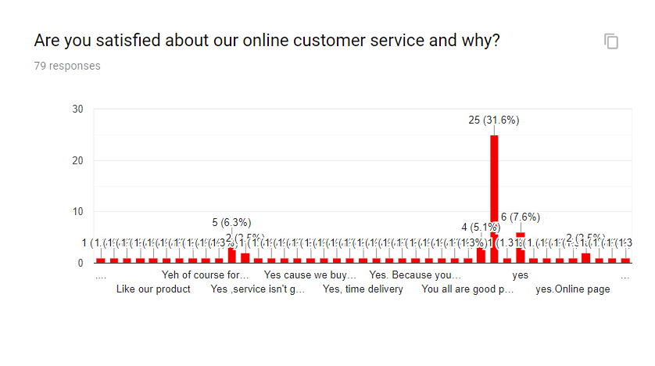
Survey Results

Slide 24
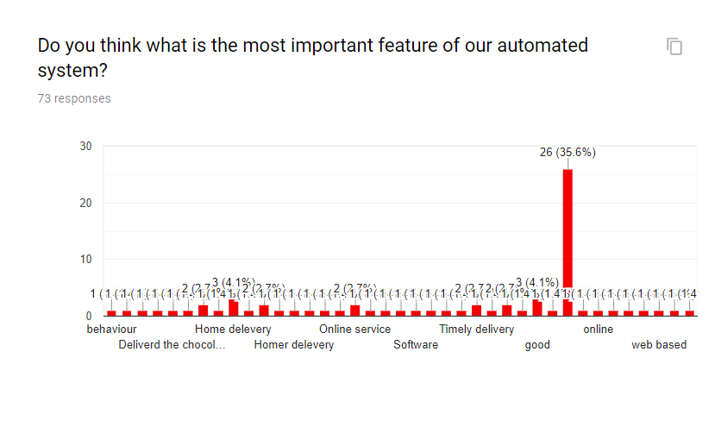
Survey Results

Slide 25

Investigation
Good quality and rate.
Dark chocolate a popular health choice.
Dairy milk, kitkat and sugary most demandable.
Customer satisfaction is good.
Cost is affordable.
In outside countries chocolate is highly demanded and favourite of people. Bangladesh has also a good demand of chocolate.

Slide 26
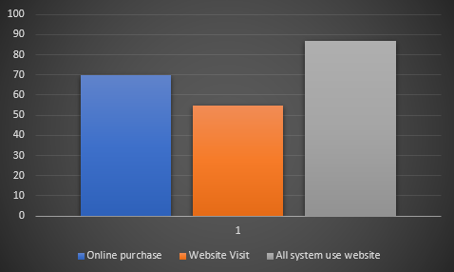
Investigation
Yearly report of the exploration 2019 shopno shop.

Slide 27
Revised Requirement Analysis
Foreign chocolate from this automated chocolate shop.
Various branded chocolate from this automated chocolate shop.
Chocolate management system is web based.
Chocolate shop our economical condition will increased.

Slide 28
Summary
Added a new feature for the customer so that they will be more helpful from our services.
Publicity of the automated system in our to days whole project work.

Slide 29

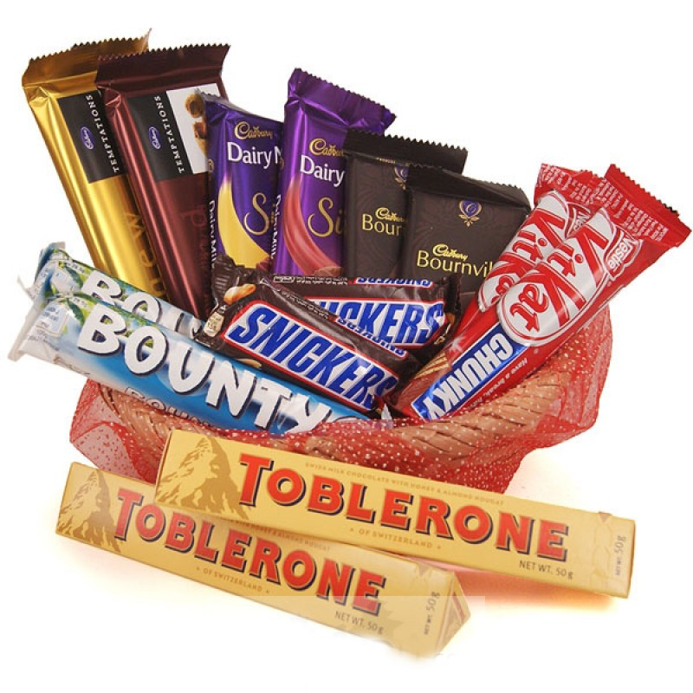

Slide 30

Thank You

